Slide 1
Programming in Java
J. Verlin
Computer Science
November 2016-March 2017

Slide 2
Do Now: November 28, 2016
Do Now: log in to your Khan Academy accounts and take out your notebooks.

Slide 3
Do Now: November 29, 2016
On the slips provided, write your name and today’s date in the upper left corner. Using only 1 word, write the answers to the following questions (15 quiz pts.):
Values inside parentheses are called _______________.
Another word for commands is _______________.
Values and parentheses taken together are called _______________.

Slide 4
Do Now: November 30-December 2, 2016
Nov. 30: Log in to your Khan Academy accounts and take out your notes from yesterday.
Dec. 01: Log into your Khan Academy accounts and load the Christmas tree project you started yesterday.
Dec. 02: take out your notebooks and copy today’s board notes.

Slide 5
November 28-December 2, 2006: Snowmen
Objective: be able to analyze a scene in order to create an animation sequence with a background, foreground and at least 1 animated element.
Unit Intro.: JavaScript
Terminology
Functions
Arguments
Parameters
Shapes
Ellipses
Rectangles

Slide 6
November 28-December 2, 2006: Snowmen
Objective: be able to analyze a scene in order to create an animation sequence with a background, foreground and at least 1 animated element.
November 28: in pairs, draw 7 concentric ellipses in decreasing size using the 7 spectral colors in the standard order of chromaticity (30 classwork points).
November 29: independently, complete the “Simple Snowman challenge” on Khan Academy (30 classwork points).
November 30: in pairs, draw a Christmas tree consisting of at least 10 shapes of varying sizes and colors consisting of rectangles, triangles, points, lines and ellipses (30 classwork points).
December 1: independently, complete the “Waving Snowman challenge” on Khan Academy (30 classwork points).
December 2: complete the ”Wild Animal” project (10 project points).

Slide 7
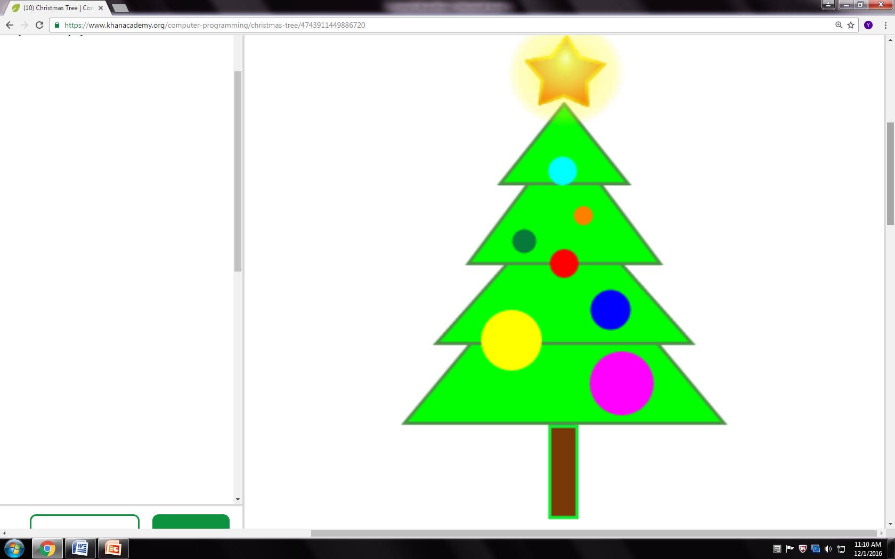

Slide 8
Homework
By Tuesday: create at least 3 ellipses of differing sizes and colors in a blank web page using no more than 20 lines of code.
By Thursday: create at least 5 shapes of varying sizes and colors consisting of ellipses and rectangles.

Slide 9
Do Now: December 5, 2016
Log in to your Khan Academy Accounts and navigate to the following:
Under “Subjects”, click “Computer Programming”.
Click “Intro. To JS: Drawing and Animation”.
Under the section “Coloring”, click on “Challenge: Sunny snowy day” and complete the challenge. There are 4 steps (20 quiz points).

Slide 10
Do Now: December 6-7, 2016
Load your “Wild Animal” projects for inspection.

Slide 11
December 5-7, 2016: Wild Animals
Objective: the students will be able to create a drawing of a wild animal in JavaScript consisting of at least 30 drawing objects (about 50 lines of code) using instances of the following functions: ellipse, rectangle, triangle and line. Fill and stroke patterns may also be used.
Direct Instruction: functions (ellipses, rectangles, triangles, lines and fills)
Independent Practice: construction of wild animals (30 project points)

Slide 12
Do Now: December 8, 2016
In your notebooks, write the definition of the word “variable” (5 classwork points).

Slide 13
Do Now: December 9, 2016
In your notebooks, write at least 2 sentences explaining the importance of variables in animation (10 classwork points).

Slide 14
December 8 & 9, 2016: Variables
Objective: the students will be able to render an animation sequence showing a yellow ellipse increasing in width and height using JavaScript.
Direct Instruction:
Dec. 8: variables (definition, declaration and assignment)
Dec. 9: variables (animation demonstrations)
Independent Practice: bucktooth bunnies (60 classwork points)

Slide 15
Do Now: December 12, 2016
Log on to http://www.khanacademy.com.
Complete the “Funky Frog” challenge within the “Variables” section of the “Intro. to JS: Drawing and Animation” module (20 quiz points). Note that there are 2 steps to this task. Both must be completed to receive full credit.

Slide 16
Do Now: December 13, 2016
Log on to http://www.khanacademy.com.
Finish the “Parting Clouds” challenge from yesterday (30 classwork points).

Slide 17
December 12, 2016: Basic Animation
Objective: the students will be able to render an animation sequence showing a yellow ellipse increasing in width and height using JavaScript.
Direct Instruction
Animation
Function
Independent Practice: “Parting Clouds” Challenge (30 classwork points).

Slide 18
Do Now: December 14, 2016
Log on to your Khan Academy accounts.
Click on the “Shooting Star” project within the “Animation Basics” section of the “Intro. to JS: Drawing and Animation” module.

Slide 19
December 13, 2016: Basic Animation Mods.
Objective: the students will be able to render an animation sequence showing either a moving “Funky Frog” or more than 2 clouds parting from an expanding yellow sun.
Direct Instruction: Moving Entire Drawings
Independent Practice (do 1 of the following, BONUS for 2):
“Funky Frog” mod.: make the entire drawing move left then right
“Parting Clouds” mod.: modify the program so that 2 clouds move from both directions instead of one.

Slide 20
December 14-20: Shooting Star Project
Objective: the students will be able to use the draw function in order to create a cityscape animation sequence.
Direct Instruction: showcase projects
Independent Practice (50 project points, due Dec. 20)
Background: night scene using 20+ points/ellipses for “stars”
Buildings: 5+
3+ styles
3+ decorations on top (see showcase projects)
10+ windows on each building showing 2 different intensities
1+ animation sequence (bonus points for more)

Slide 21
Do Now: December 21, 2016
Copy the following terms in your notebooks:
Text
String

Slide 22
December 21-22, 2016: Mouse Interactivity
Objective: the students will be able to draw a series of at least 10 overlapping ellipses where the width and intensities of red and green vary relative to the “x” and “y” coordiantes of the mouse cursor.
Direct Instruction: user interaction with mouseX and mouseY
Independent Practice: “Interactive Programs” challenge.

Slide 23
Do Now: January 4, 2017
Copy the following terms to your notebooks:
Text
String

Slide 24
Do Now: January 5, 2017
Quiz (20 quiz points): the animation in the ensuing slide does not work. Two lines of code have been left out – one at the beginning of the animation sequence and another at the end of the program.

Slide 25
Do Now: January 6, 2017
Log into your Khan Academy accounts and load yesterday’s project.

Slide 26
January 4-6, 2016: Text Processing
Objective: the students will be able to process text in order to create a product advertisement with at least 2 instances of animation.
Direct Instruction: https://www.khanacademy.org/computer-programming/simplified-pet-rock/6327396379197440
random(x,y)
fill(r, g, b);
textSize(x);
text({“message”}, x, y,);
mouseX
mouseY

Slide 27
January 4-6, 2017: Text Processing
Guided Practice: “My Favorite Foods” challenge
Cooperative Practice: redo “Mouse Tracker” challenge (10 classwork points)
Independent Practice: create an ad design for a product with a title, subtitle and at least 1 graphic object from the image library which moves with the mouse (25 project points).

Slide 28
Do Now: January 9-18, 2017
Log into StudentNet and list all of the assignments of type “Classwork” and “Projects” which you have not yet completed (10 classwork points).

Slide 29
January 9-18, 2017: Make-up Work
Because of Keystone testing this week and much of next week, I will not be teaching any new content. We will use the time for making up missing work.
Confer with me about requirements for each assignment.
You will receive up to 75% credit for all completed assignments.

Slide 30
Do Now: January 19, 2017
Look at the image on the right.
Write how many different types of shapes you see.
Write how many of each type there is.
Estimate how many lines of code you think is required to render the picture.

Slide 31
January 19 & 20, 2017: Functions
Objective: the students will be able to write functions in order to make their code reusable.
Direct Instruction: functions and code reuse
Independent Practice: “Moles in Holes” challenge (30 classwork points)
Do the actual challenge.
Transform the 4 ellipse commands at the bottom into a single function like drawMole and call it 4 times.

Slide 32
Do Now: January 20, 2017
Look at the following code at the right. Find the 2 syntax errors which cause it not to run. What would be the output after fixing the errors (5 quiz points)?
var drawMole = function(moleX, moleY)
// head
noStroke();
fill(125, 93, 43);
ellipse(moleX, moleY, 60, 60);
// face
fill(255, 237, 209);
ellipse(moleX, moleY+10, 33, 28);
// eyes
fill(0, 0, 0);
ellipse(moleX-10, moleY-15, 10, 10);
ellipse(moleX+10, moleY-15, 10, 10);
}

Slide 33
Do Now: January 23, 2017
Log on to http://www.khanacademy.org and complete the “Quiz: Variable Expressions” within the “Bonus: Resizing with Variables” module of the “Intro. JS Drawing and Animation” class (5 quiz points).

Slide 34
January 20-23, 2017: Return Values
Objective: the students will be able to write functions in order to draw a fish aquarium.
Direct Instruction: Review of Functions and Return Values
Guided Practice: ”Calculator” challenge
Guided Practice: Requirements Analysis (Fish Aquarium)
Cooperative/Independent Practice: Fish Aquarium Project (50 project points)

Slide 35
Do Now: January 24, 2017
From the sample code on the right, predict the starting place on the screen of the yellow ellipse. Also predict the direction of its movement.
var xPos1 = 200;
var yPos1 = 200;
draw = function() {
xPos1=xPos1+1;
yPos1=yPos1+1;
background(29, 40, 115);
fill(255, 242, 0);
ellipse(xPos1, yPos1, 10, 10);
};

Slide 36
Do Now: January 25, 2017
Load the fish aquarium project for inspection.

Slide 37
January 24 & 25, 2017: Return Values
Objective: the students will be able to call previously written functions in order to draw a fish aquarium.
Review of Functions
arguments
parameters
Return Values

Slide 38
Do Now: January 26, 2017
Read the code sample on the right. Write down the event which the user must initiate in order for a red ellipse to appear. Where will it appear once this event happens?
noStroke();
fill(235, 38, 81);
draw = function() {
if (mouseIsPressed) {
ellipse(mouseX, mouseY, 20, 20);
}
};

Slide 39
January 26, 2017: “If” Statements
Objective: the students will be able to code an “if” decision structure in order to write a “bouncy ball” program.
Direct Instruction: “Bouncy Ball” challenge
Independent Practice: “More Mouse Interaction” (30 classwork points)
Basic syntax:
if ({condition}) {
{Run this code.}
}

Slide 40
Do Now: January 27, 2017
Log into Khan Academy.

Slide 41
January 27, 2017: “If” Statements
Objective: the students will be able to incorporate an if-then-else construct in order to be able to create an application with a button which changes color when clicked upon.
Direct Instruction: “Number Analyzer” challenge
Independent Practice: “Flashy Flash Card” (30 classwork points)

Slide 42
Do Now: January 30, 2017
Write the range of “x” and “y” coordinates the mouse cursor must be for the fill statement (look right) to run. (i.e. x must be between…, y must be between…).
if (mouseIsPressed && mouseX>=50 && mouseX<=300 && mouseY >=150 && mouseY<=250){
fill(0,0,255);
};

Slide 43
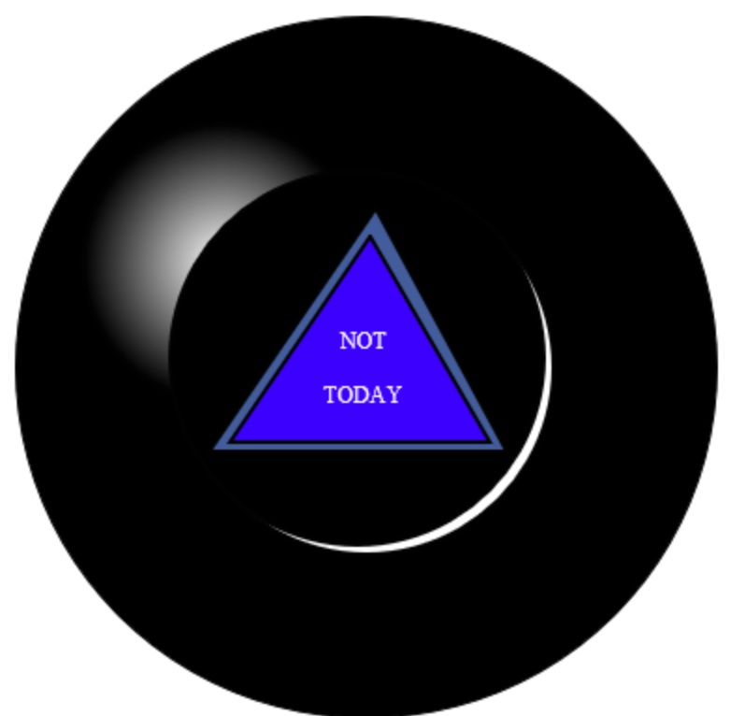
January 30-Feb. 6: Magic 8-ball Game
Objectives:
Be able to analyze project requirements in order to create a magic 8-ball game.
Be able to use a series of if-blocks and a random number generator in order to create a magic 8-ball computer game.

Slide 44
January 30-Feb. 6: Magic 8-ball Game
Direct/Guided Instruction: requirements analysis
Independent/Group Practice: code the requirements

Slide 45
Do Now: February 6, 2017
List 6 responses the magic 8-ball should have (ex.: “Yes”, “No”…)

Slide 46
February 6, 2017: “If-Then-Else”
Objective: the students will code the logic behind the magic 8-ball project.
Demonstration Video: “If/Else -- part 1”
Direct Instruction: random number generator
Independent Practice: use the random number generator together with at least 6 “if” blocks and code the logic behind the magic 8-ball project. It is due at the end of class (60 project points).

Slide 47
Do Now: February 7-8, 2017
Log on to the site you created on http://www.weebly.com last fall. If you haven’t yet created a site on Weebly, do so now.

Slide 48
February 7 and 8, 2017: Project Showcase
Objective: the students will be able to create a website on http://www.weebly.com in order to showcase their work on their Magic 8-ball project.
The website must contain a page which professionally showcases the following project elements (40 project points):
Runtime Pictures
Requirements Analysis
Code
Design Documentation

Slide 49
Do Now: February 9 (10), 2016
Predict the output of the following code:
var i = 0;
while(i < 3) {
println("hi");
i++;
}

Slide 50
February 9 (10), 2017: Looping Structures
Objective: the students will be able to use for-while loops in order to draw a house which must include a roof, front, 4 windows, siding extending along the perimeter of the house and grass at the bottom (using at least 1 image).
Direct instruction: for-while loops
Guided practice: The Loopy Ruler
Independent practice: Loopy Landscape
Homework (due Feb. 15): complete the Constellation Maker challenge on Khan Academy.

Slide 51
February 10-15, 2017: Do-While Loops
Objective: the students will be able to use for-while loops in order to draw a house which must include a roof, front, 4 windows, siding extending along the perimeter of the house and grass at the bottom (using at least 2 images from the Khan Academy images library).
Direct instruction: do-while loops
Guided practice: Lined Paper
Project: Build-a-House

Slide 52
Do Now: February 16, 2017
Log on to the Intro JS class on http://www.khanacademy.org and proceed to the section on writing clean code. Complete the online quiz. When you see the result screen, stop and show me your results.

Slide 53
Do Now: February 17, 2017
Quiz: identify the two errors in the following code and show me your “Favorite Animals” homework:
var favAnimals = ["Cat", "Elephant", "Parrot"];
var i = 0
var moreAnimals = ["Cat", "Elephant", "Parrot", "Dog", "Hamster"];
while (i < favAnimals.length) {
fill (255, 0, 0);
text(favAnimals[iii], 10,30+10*i);
I++;
}

Slide 54
February 16 & 17, 2017: Arrays
Objective: the students will be able to store multiple values in variables using arrays in order to create an animated drawing consisting of a series of small dots moving simultaneously from the top of the screen to the bottom.
Direct Instruction: Arrays
Guided Practice: Favorite Fruits
Project: Favorite Animals

Slide 55
Do Now: February 21, 2017
Load the “Favorite Animals” project from last week for one final check-off.

Slide 56
Do Now: February 22-23, 2017
Feb. 22: log on to http://www.khanacademy.com and create a blank JavaScript program.
Feb. 23: log on to http://www.khanacademy.com and load your “Make It Rain” project.

Slide 57
February 21-23, 2017: Arrays
Objective: the students will be able to store multiple values in variables using arrays in order to create an animated drawing consisting of a series of small dots moving simultaneously from the top of the screen to the bottom.
Direct Instruction:
Array Methods (length, push and pop)
Mouse Buttons (mouseClicked, LEFT and RIGHT)
Guided Practice: Constellation Maker
Project: Make it Rain: translate the plain English steps on the handout in order into JavaScript (due Feb. 23, 20 project points)

Slide 58
Do Now: February 24, 2017
Copy the following terms:
Object: a single variable which stores multiple pieces of related information
Property: the bits of information which tell the computer what the object is about
Value: the quantity/quality of the property
Reference: object.property
Example of an object:
var person {
ID: 3345678,
lastName: Smith,
firstName: John,
Age: 17,
graduated: false
};

Slide 59
Do Now: February 27-28, 2017
Quiz (10 quiz points): on the slips provided, write your name, today’s date. Identify the object variable, one property of the object and at least three syntax errors in the following code sample:
var person {
ID 3345678
lastName: Smith
firstName: John
Age: 17
graduated: false

Slide 60
February 24-27, 2017: Objects
Objective: the students will be able to store values in multiple properties of objects in order to draw a bookshelf with at least 2 books on it which will consist of at least 2 rectangles of at least 1 color, with authors and titles.
Direct Instruction: objects
Guided Practice: Recipe Card Challenge
Independent Practice: Modifying Objects and Picture Painter

Slide 61
Do Now: February 28, 2017
In one sentence, distinguish between a property of an object and a value.

Slide 62
February 28, 2017: Objects
Objective: the students will be able to store values in multiple properties of objects in order to draw a bookshelf with at least 2 books on it which will consist of at least 2 rectangles of at least 1 color, with authors and titles.
Direct Instruction: Review of Objects
Independent Practice: Bookshelf project (due end of next class, 30 project points)
Homework: finish the Bookshelf project.

Slide 63
Do Now: March 1, 2017
In one sentence, define what a scene is.

Slide 64
Do Now: March 2, 2017
Load your Storyteller code for inspection.

Slide 65
March 1-2, 2017: Scene Management
Objective: the students will be able to use mouse click events in order to change at least 6 screens which contain at least 1 text object, 1 graphics object and 2 navigation buttons.
Direct Instruction: scene management (storyteller script)
Guided practice: screen changes using mouse click events
Cooperative Learning: create at least 5 additional scenes with text and at least 1 image using a mouse click event to change the screen.

Slide 66
Do Now: March 3, 2017
Log in to Khan Academy and load your Storyteller.
Quiz (20 quiz points): 5 min.
starting on line #4, create an object variable btnBack.
Assign it the following properties and values: x: , y:, colorR: 255, colorG: 0, colorB: 0, text: “Back”, width: 62 and height: 50. There must be a total of 10 lines when complete.

Slide 67
March 3, 2017: Buttons
Objective: the students will be able to create at least 2 buttons in order to be able to navigate through a sequence of at least 2 screens:
Direct Instruction: the “Rabbit Racer” challenge
Guided Practice: button and draw function templates
Independent Practice: finish coding the “Rabbit Racer” challenge (30 classwork points).

Slide 68
Do Now: March 6, 2017
Log in to Khan Academy and load your Storyteller.
RE-Quiz (20 quiz points): 5 min.
starting on line #4, create an object variable btnFirst.
Assign it the following properties and values: x: 200 , y: 200, colorR: 0, colorG: 0, colorB: 255, text: “First”, width: 62 and height: 50. There must be a total of 10 lines when complete.

Slide 69
Do Now: March 4-7, 2017
Load your Storyteller projects for inspection.

Slide 70
March 4-7, 2017: Storyteller Project
Take a copy of the storyboard handout. Using, the “Storyteller” challenge as a template, proceed to map a simple story of your own consisting of at least 6 separate screens. At a minimum, each screen must have:
1 text object
1 image object
2 button objects allowing the user to navigate to the next or previous screen
This project is due Tuesday, March 7 (60 project points).

Slide 71
Do Now: March 8, 2017
Load your Storyteller projects for final inspection (30 classwork points). The assignment must contain:
1 title slide
5 slides with 1 graphic and 1 line of text
Scene changes only when back and Next buttons are clicked

Slide 72
Do Now: March 8, 2017
We will begin the unit project today. Please do the following:
Form a group of 3.
Read the project selection packet in your small groups. Each group will be responsible for completing 1 project.
As a group, mark your 1st, 2nd and 3rd choices on the attached choice board along with the names of each group member and turn in the choice board (10 project points).

Slide 73
March 8 and 9, 2017: Narratives and IDE
Objectives: the students will be able to write a project narrative in order to be able to define and describe project work performed by student for each day.
Direct Instruction:
Proposals (due March 8, 20 project points)
Choice board selection
Hand-drawn sketch of interface
Requirements list (see Magic 8-Ball)
Narratives (due March 15, 20 project points)
Project Drafts (due March 15, 50 project points)

Slide 74
Do Now: March 9-15, 2017
Take out your project narrative spreadsheets for inspection.

Slide 75
March 9-15, 2017: Quarterly Coding Project
Objectives:
The students will be able to develop a short JavaScript (500 lines max.) in order to produce a video game, educational application or digital artwork (first draft due March 15, 50 project points).
The students will be able to work and communicate effectively in small groups of either 2 or 3 people.

